Slide 1






Global Pizza Network
Secure & redundant WAN network simulation for Global Pizza
Mostafa Mohamed Ahmed Saleh
Ahmed Khaled Elsayed

Slide 2
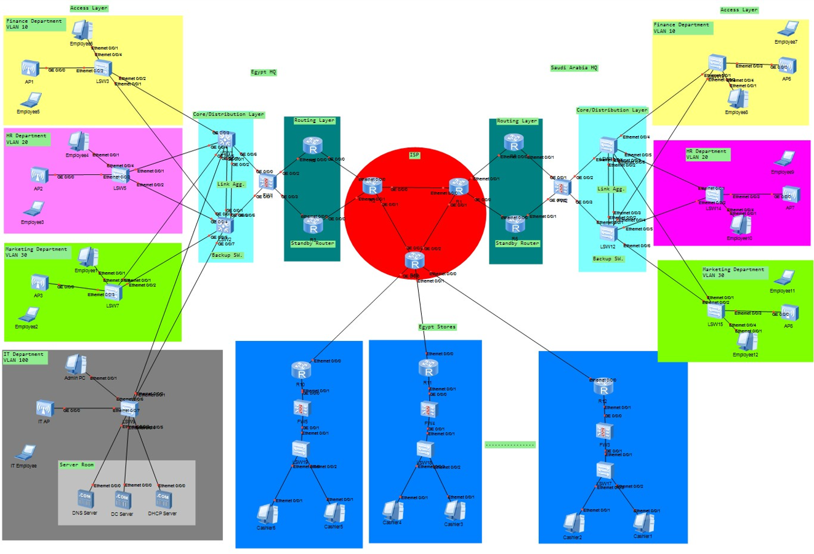
Executive Summary
Objective: To design, and simulate a highly available and secure Wide Area Network infrastructure for Global Pizza expanding operations in Egypt and Saudi Arabia using Huawei's eNSP.
99.9% Uptime for critical point-of-sale (POS) and inventory systems.
Secure Encrypted Communication between all stores and Headquarters.
Cost-Effective Design through simulation, identifying potential issues before costly physical implementation.

Slide 3
Business Needs & Challenges
Business Needs: Growth and expansion of retail stores across Egypt and Saudi Arabia.
Current Challenges:
No secure, reliable network connecting stores to HQ.
Risk of downtime affecting sales and operations.
Manual reporting processes; no real-time inventory visibility.
Proposed Solution: gateways, and dedicated firewalls, validated network design featuring redundant VPN architecture.

Slide 4
Proposed Network Design Overview
Two Headquarters (Hubs): Cairo, Egypt and Riyadh, Saudi Arabia.
Hub-and-Spoke VPN Model: All retail stores (Spokes) securely connect to the nearest HQ (Hub).
Key Components per HQ:
2-Tier Hierarchy: Core and Access layers for efficient traffic management.
Redundant Firewalls: For stateful inspection and VPN termination.
Gateway Redundancy Protocol: Two gateways where one is Active and one is Standby for seamless failover.
Key Component per Store:
Store Firewall: To establish secure VPN tunnels to the HQ.

Slide 5
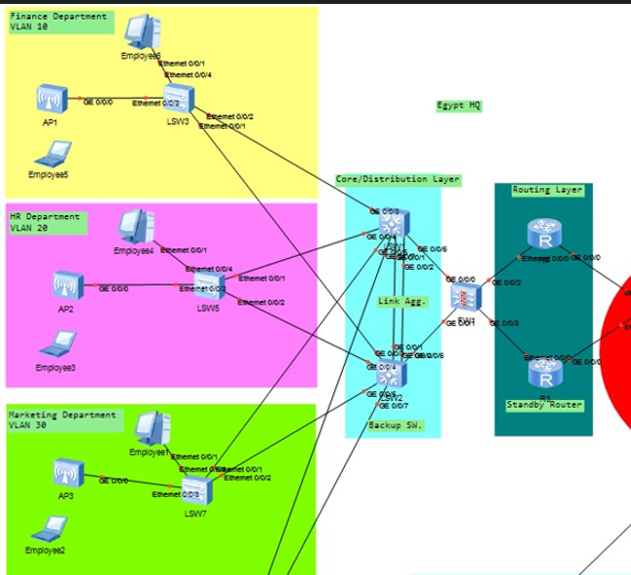
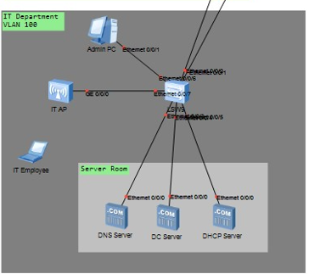
HQ Network Design (eNSP)
Core Layer: Core-SW - Inter-VLAN routing & connectivity to firewalls.
Access Layer: Access-SW - Connects internal servers (POS, Inventory, Database).
Firewalls: FW1 & FW2 in active/standby HA pair. Terminate site-to-site VPNs.
Routers/Gateways: R1 & R2. R1 is master for default gateway traffic to the internet.

Slide 6
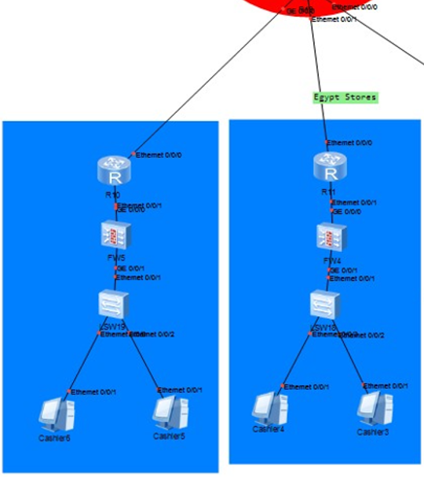
Store Network Design (eNSP)
Store Firewall: The key device. Configured with VPN to initiate a tunnel to the HQ's public IP.
Local Network: Simple flat network or a single VLAN for store devices.

Slide 7
Project Phases & Timeline
Phase 1: Planning & IP Scheming
Define IP addressing (public/private), VPN parameters.
Phase 2: HQ Setup
Build and configure both Egypt and Saudi HQ sites in eNSP.
Phase 3: Store & VPN Setup
Build multiple store topologies and establish VPN tunnels to the HQs.
Phase 4: Testing & Validation
Test failover, test VPN establishment and validate traffic flow.
Phase 5: Documentation & Presentation
Export configurations, finalize diagrams, create presentation.

